Slide 1
Bacterial Interactions
Tony Lam
October 10, 2016
Notes:
Self Introduction
b/b b/h interaction focusing on some of the available computational approaches used to observe these interactions
I cannot talk about all the papers I’ve read but I will talk about some of the papers I found interesting.

Slide 2
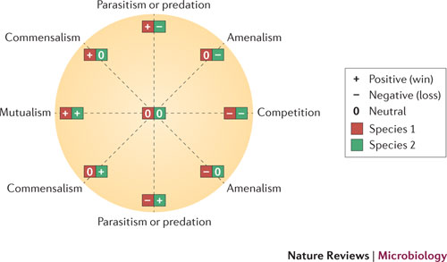
http://www.nature.com/nrmicro/journal/v10/n8/images/nrmicro2832-f1.jpg
Notes:
When we typically think of bacterial interactions we can group them into several categories.
Some of the general interactions which immediately come to mind are SS, QS, Biofilm, Antibiosis.
These are types of community assembly, metabolic interactions and protein interactions.
And currently, there have been a lot of research focus towards analyzing these interactions through community wide approaches
Through this presentation b/b -> b/h

Slide 3
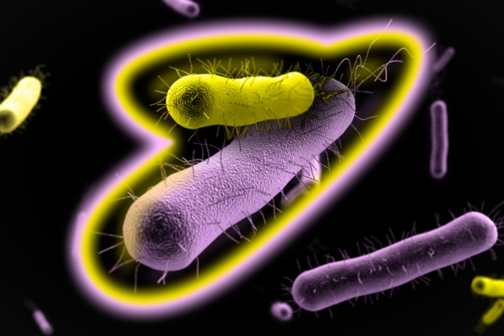
http://news.mit.edu/sites/mit.edu.newsoffice/files/styles/news_article_image_top_slideshow/public/images/2016/MIT-Bacterial-Coop-1_0.jpg?itok=EZuoBZ8g
Notes:
Throughout my readings, began to notice many different techniques used to explore b/b interactions, and many used these techniques to study specifically community assortment and species co-occurrence.
Microbial communities play an important role in the maintenance and stability of many ecosystems, as well as in humans.
They facilitate not only nutrient allocation but also play vital roles in host immune responses and pathogenicity.
Thus, understanding the mechanisms which govern population dynamics and community assembly is an important first step in understanding natural communities as well as microbiome manipulation.

Slide 4
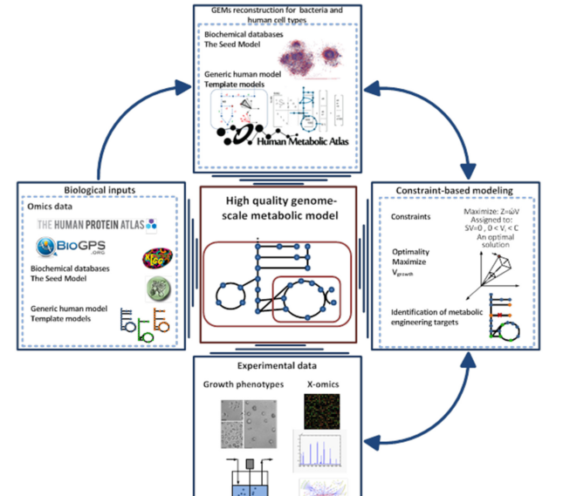
Shoaie et al.
Notes:
One of the techniques to study b/b interactions I encountered was the utilization of GEMs (genome scale metabolic modeling)
GEMs are constructed using genomic data with inputs from genomic databases as well as experimental and constraint inputs.
GEMs give insight into the nutritional requirements, resource competition and species cooperation.
When paired with species co-occrence data they allow insight to how species cooperation and competition shape community assemblies.

Slide 5
Metabolic modeling of species interaction in the human microbiome elucidates community-level assembly rules Roje Levy and Elhanan Borenstein

Slide 6
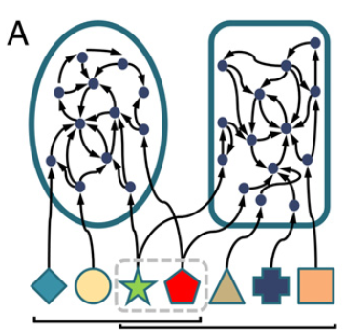
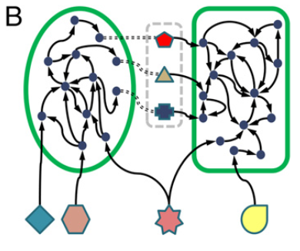
Metabolic competition index
Metabolic complementarity index
Levy et al.

Slide 7
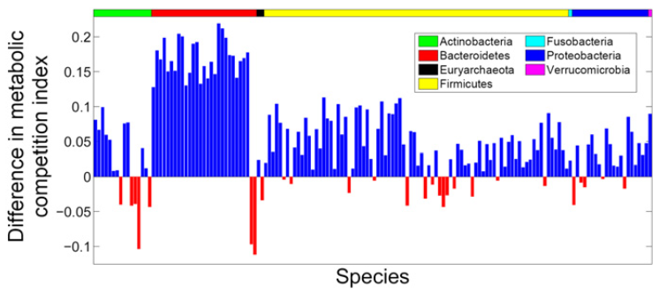
Levy et al.
Notes:
Comparison between partner species and excluder species.
Measure the metabolic competition of both showed difference.
Partner species have higher metabolic competition than excluder species.
Bars represents the metabolic competition between partner species
82% of species have higher metabolic competition index with partners (blue bars)
This suggested that population dynamics were modulated by habitat filtering.
Some of the problems with this approach,
Pairwise, metabolic weight, ignores other variables.

Slide 8
Metabolic dependencies drive species co-occurrence in diverse microbial communities Aleksej Zelezniak et al.
Zelezniak et al.

Slide 9
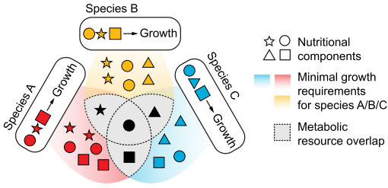
Zelezniak et al.
Notes:
proposed fluxed based GEMs model
This allowed for higher order comparison up to 4 species comparison vs levy’s method which only allowed pairwise.
Zelezniak's approach differs from Levy by incorporating mass balance and growth constants through fluxed based analysis, with the assistance of the ModelSEED pipeline.

Slide 10
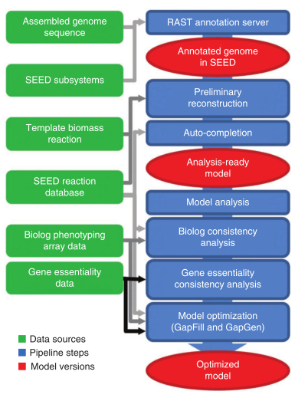
Zelezniak et al.
Notes:
ModelSEED pipeline – used for genome scale metabolic modeling

Slide 11
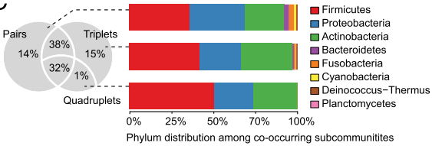
Zelezniak et al.
Notes:
From the results, it was found that many species (16%) only exhibited interactions in triplets or greater.
This shows the importance of analyzing higher order interactions
Habitat filtering vs species assortment
While these two approaches give a sense of community assortment, they only allow a view through a taxonomic approach.
T

Slide 12
Transcriptional interactions suggest niche segregation among microorganisms in the human gut Plichta et al.
Plichta et al.
Notes:
Keeping that question in mind, we turn our attention to:
Plichta utilizes a transcription based method to try understand community assembly within the human gut microbiome.

Slide 13
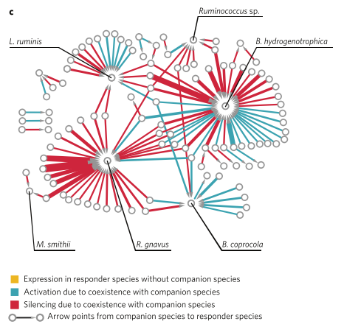
Plichta et al.
Notes:
The purpose of this paper was to identify potential interspecies transcriptional interactions/gene regulation.
Tested for differential gene expression associated with pairwise species co-occurrences
Compared the expression of a gene in responder species when a companion species was present and weren't present.

Slide 14
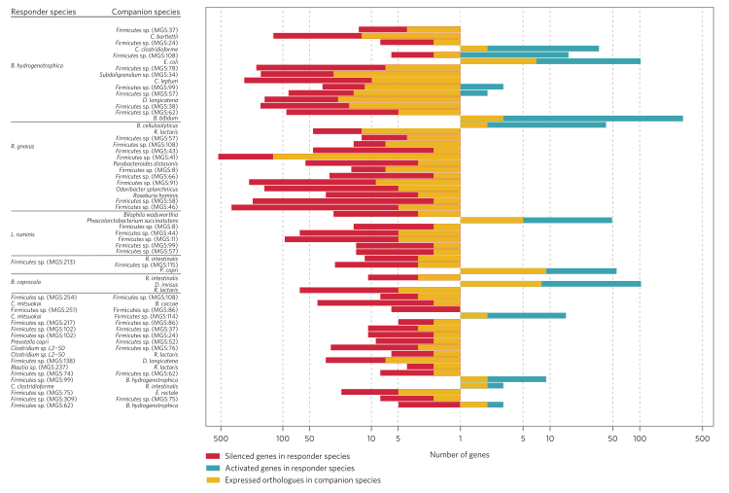
Plichta et al.
Notes:
Observed changes in transcriptional interactions in response to the presence of companion organisms.
For example: C. mitsuokai and B. caccae are known to both express starch phosphorylase. However, in co-existence, C. mitsuokai’s orthologue genes were silenced in the presence of B. caccae. This may have been because B. caccae is a specialist in polysaccharide metabolism and may have depleted the available starch resource.
Majority of ortholog genes (78%) were seen to be downregulated during coexistence.

Slide 15
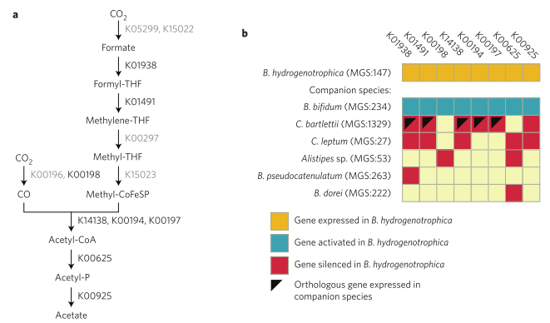
Wood-Ljungdahl Pathway
Plichta et al.
Notes:
Wood-Ljungdahl pathway
[explain]
They found that in coexistinc species, many orthologous genes were downregulated. this suggests there was regulation to decrease the overlap of expressed functions in interacting species pairs and that the human gut microbiome undergoes niche segregation at the transcription level.
This can explain how we saw how species with potential competitive functionality, coexisting with each other.
We can start to see how these different approaches, complement each other while also see how some approaches are limited by what they can see.

Slide 16
Integration of time series analysis understand interaction on a community wide level
Notes:
Next we move on to the usage of time series analysis in understanding community dynamics.
In recent years, much attention has gone towards trying to understand the human microbiome. Specifically, the stability of the microbiome, and the transition between stable and diseased states;
Q: How stable is the microbiome, what factors are involved with the maintenance of stability and what causes the shift between a stable state towards a diseased state.
The next two papers tries to analyze the stability of the human microbiome through time series analysis.
Time series analysis allows us to view microbial developments over extended periods of time, to give us a better understanding of community dynamics.
Dynamic analysis vs static analysis: this allows us to see how maybe specific events may play a role in community assembly

Slide 17

The Long-Term Stability of the Human Gut Microbiota – Faith et al.
Temporal Stability of Human Skin Microbiome – Oh et al.
http://assets.illumina.com/content/dam/illumina-marketing/images/applications/microbiology/v2/intro-human-microbiome-analysis.jpg
Notes:
The Long-Term Stability of the Human Gut Microbiota – Faith et al.
Found remarkable stability of gut microbiota with on average 60% of strains remaining over a period of 5 years
Found in related individuals, genome content were maintained up to 96%
Temporal stability of human skin Microbiome – Oh et al.
Found skin microbiome were stable over time despite being exposed to the elements.
Presents hypothesis of colonization resistance
Site tropism, individuality and phylogeny were key determinants of stability.
Ex. Feet were variable
Individuality, some people exhibited drastic shift in diversity, thus might be due to hygiene
Used SNV analysis to determine that strains are maintained rather than reacquired.
Up to 2 years stability
Samples were done in long 1-2 year intervals and short 1-2 month intervals

Slide 18
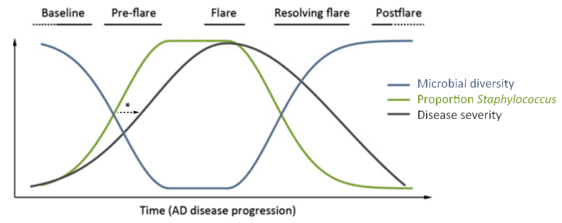
Kong et al.
Notes:
What changes between a stable state and a diseased state?
Temporal shifts in the skin microbiome associated with disease flares and treatment in children with atopic dermatitis Kong et al.
Generalization:
The paper used time series analysis to monitor the microbial community of atopic dermatitis individuals. What the paper found was that there was correlation between the population Staphylococcus species during the progression of the disease. Also that there was a decrease in microbial diversity during the progression of the disease.
The findings of this paper suggest that there are certain key events (decrease in diversity and disruption of microbial stability) which can be attributed to the onset of certain diseases.
And these types disease progressions can be seen across different microbial communities.

Slide 19
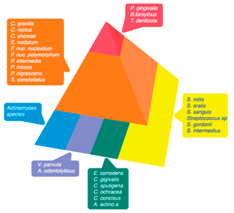
http://assets.illumina.com/content/dam/illumina-marketing/images/applications/microbiology/v2/intro-human-microbiome-analysis.jpg
Notes:
The previous example highlights the fact that certain diseases can be characterized by the progression of certain keystone species. For example, it is known that the development of oral biofilms follow a sequential and ordered colonization during the progression of gingivitis and periodontis. There are certain colonizing bacteria which are considered “early colonizing species” which are usually associated with adhesion to oral surfaces, and also others are classified as “last colonizing species” which are associated with virulence. And in oral biofilm progression these species are grouped into purple, blue, green, yellow, orange, and red cluster/complex species. And red being the species typically associated with periodontitis. And the colonization of last species is reliant on the colonization of early colonizaers.
So there is talk about how to better understand these community dynamics and try to treat these dieses by interrupting the chain of colonization

Slide 20
Community-wide transcriptome of the oral microbiome in subjects with and without periodontitis Duran-Pinedo et al.
Notes:
While there is a lot of information on the phylogenetic composition of communities, little is known about the transcriptional interactions between these diseased states.
While knowing the taxonomic composition of the community is important, it is also important to understand the gene expression between these microbial communities.

Slide 21
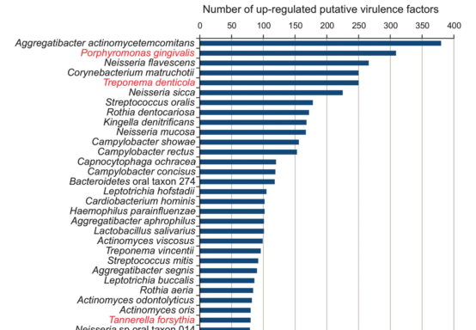
Notes:
What they found was that majority of the virulence factors which were upregulated during periodontitis came from organisms which were not considered major periodontal pathogens. Usually the organisms which are associated with periodontitis is red complex species which are labeled in red.
Members of the genus Streptococcus such as S. mitis, generally associated with health, were expressing homologs of virulence factors from known pathogenic streptococci such as; neuramini- dase A (Jedrzejas, 2001), zinc metalloprotease ZmpB (Bender and Weiser, 2006) and the saliva-binding protein adhesin B (Herbert et al., 2004).
Findings there may be synergetic interactions between communities, and that in terms of community dynamics, it may be necessary to reconsider species which are not commonly associated with a disease state as a factor in the progression/onset of these diseases.

Slide 22
Dual transcriptomics / Dual RNA-seq
Expression profile A
A+B
Trimming/mapping to respective genomes
RNA-seq
Expression profile B
Simultaneous Transcriptomics
A
RNA-seq
Trimming/mapping
Expression profile A
A+B
B
RNA-seq
Trimming/mapping
Expression profile B
Schulze et al. (2016)
Notes:
Difference between dual transcriptomics vs Simultaneous is, Dual you merge the two transcriptomes and sequence together (transcripts of two interacting species in 1 pool). Simultaneous, you separate the species then sequence separately.
Benefits of Dual RNA-seq:
RNA extraction w/o separation
Expression data directly reflects changes;
prevents errors obtained from separation process.
Sequencing cost is lower

Slide 23
Dual RNA-seq unveils noncoding RNA functions in host-pathogen interactions Westermann et al.
Notes:
Westermann uses Dual RNA-seq to try to noncoding RNA functions during host-pathogen interactions

Slide 24
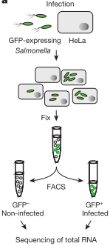
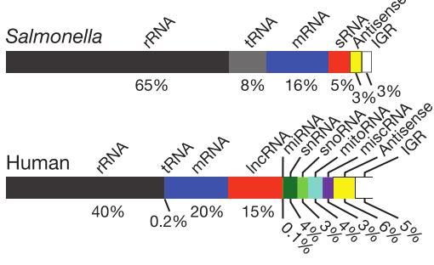
Notes:
They began with using GFP expressing Salmonella to infect HeLa-S3 human cell lines.
They then separated the cells using Fluorecence-activated cell sorting (FACS), separated infected vs unaffected cells.
They continued to do a time series analysis of the transcriptome of 0, 2, 4, 8, 16, and 24hr post salmonella infection.
Sequenced total RNA in both samples without depletion or enrichment of RNA in order to see different represented RNAs

Slide 25
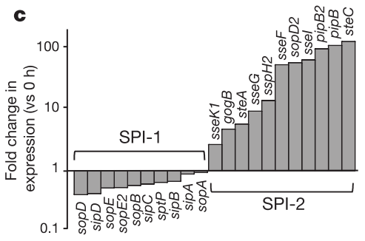
Notes:
When comparing 0h and 4h mRNA expression of Salmonella pathogenicity island SPI-1 and SPI-2, they found that SPI-1 expression decreased after bacterial internalization, and saw SPI-2 upregulation, which is involved with bacterial intracellular survival.
SPI-1 internalization
SPI-2 bacterial intracellular function

Slide 26
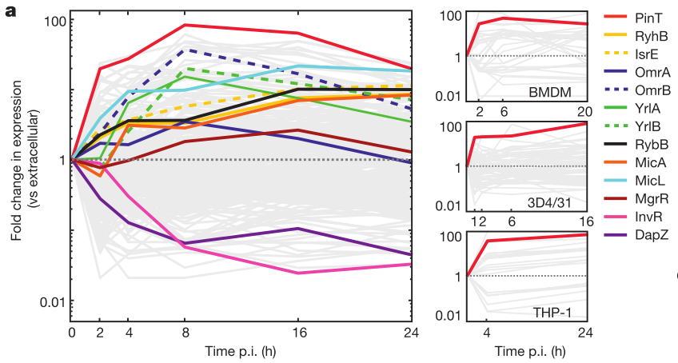
Notes:
They then profiled sRNA with high resolution over a period of 24 hrs
They found expression of the most activated sRNA, PinT x100 fold in post infection cells
PinT is an 80nt long sRNA acquired horizontally from salmonella specific locus

Slide 27
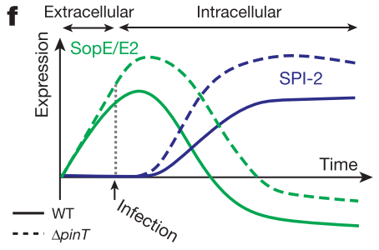
Notes:
Tested pinT knockouts and found that PinT was a timer of virulence gene expression.
They found that PinT shapes the transition from invasion to intracellular replication state of Salmonella
By suppressing SPI-1 effectors (involved with host internalization) and upregulation of SPI-2 virulence genes (involved in intracellular survival)
PinT is the first sRNA to be discovered to temporally shape transition states between two major bacterial virulence programs.

Slide 28
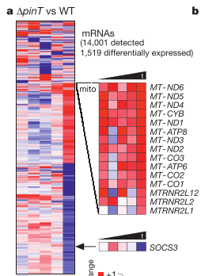
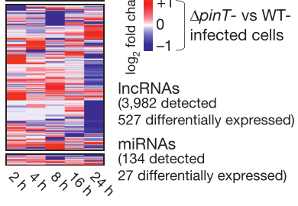

Notes:
They then tried to look for PinT dependent changes in transcriptome of infected HeLa cells.
And what they found was that WT & delta PinT have different expression patterns
Through their analysis, they found that lncRNAs (long noncoding RNA) had quick response PinT-dependent alterations and could previde useful as a sensitive marker for pathogen activities during early infection

Slide 29
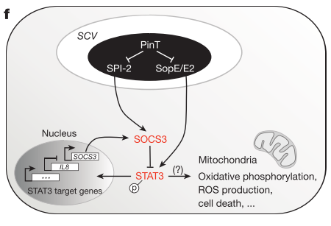
Notes:
They also found that PinT has an impact on host transcriptome throught the course of infection.
PinT dependent regulation affects SOCS3 and STAT3
SOCS3 is a key regulator in JAK-STAT pathway
The JAK-STAT signaling pathway transmits information from extracellular chemical signals to the nucleus resulting in DNA transcription and expression of genes involved in immunity, proliferation, differentiation, apoptosis and oncogenesis.
Also prevents the activation and import of STAT3 transcription factor.

Slide 30
Notes:
Through the study, it showed the role that PinT plays in the mediation of virulence gene and manipulation of host cell pathways.
Many studies often only use mRNA to study protein expression and neglect non-coding RNA.
This study shows how a single sRNA affects host –pathogen interactions at different levels and exemplifies how the analysis of all transcript classes, not just mRNA, with combination with dual RNA-seq can give new insight into roles of noncoding DNA.

Slide 32
References:
Duran-Pinedo, A. E., Chen, T., Teles, R., Starr, J. R., Wang, X., Krishnan, K., & Frias-Lopez, J. (2014). Community-wide transcriptome of the oral microbiome in subjects with and without periodontitis. The ISME Journal, 8(8), 1659–72. http://doi.org/10.1038/ismej.2014.23
Faith, J. J., Guruge, J. L., Charbonneau, M., Subramanian, S., Seedorf, H., Goodman, A. L., … Gordon, J. I. (2013). The long-term stability of the human gut microbiota. Science, 341(6141), 1237439. http://doi.org/10.1126/science.1237439
Hojo, K., Nagaoka, S., Ohshima, T., & Maeda, N. (2009). Bacterial interactions in dental biofilm development. Journal of Dental Research, 88(11), 982–90. http://doi.org/10.4161/viru.2.5.16140
Levy, R., & Borenstein, E. (2013). Metabolic modeling of species interaction in the human microbiome elucidates community-level assembly rules. Proceedings of the National Academy of Sciences, 110(31), 12804–12809. http://doi.org/10.1073/pnas.1300926110
Manor, O., Levy, R., & Borenstein, E. (2014). Mapping the inner workings of the microbiome: Genomic- and metagenomic-based study of metabolism and metabolic interactions in the human microbiome. Cell Metabolism, 20(5), 742–752. http://doi.org/10.1016/j.cmet.2014.07.021
Oh, J., Byrd, A. L., Park, M., Comparative, N., Program, S., Kong, H. H., & Segre, J. A. (2016). Temporal Stability of the Human Skin Microbiome. Cell, 165, 854–866. http://doi.org/10.1016/j.cell.2016.04.008

Slide 33
Plichta, D. R., Juncker, A. S., Bertalan, M., Rettedal, E., Gautier, L., Varela, E., … Nielsen, H. B. (2016). Transcriptional interactions suggest niche segregation among microorganisms in the human gut. Nature Microbiology, 1(August), 16152. http://doi.org/10.1038/nmicrobiol.2016.152
Saini, R., Saini, S., & Sharma, S. (2011). Biofilm: A dental microbial infection. Journal of Natural Science, Biology, and Medicine, 2(1), 71–5. http://doi.org/10.4103/0976-9668.82317
Shoaie, S., Ghaffari, P., Kovatcheva-Datchary, P., Mardinoglu, A., Sen, P., Pujos-Guillot, E., … Nielsen, J. (2015). Quantifying Diet-Induced Metabolic Changes of the Human Gut Microbiome. Cell Metabolism, 22(2), 320–331. http://doi.org/10.1016/j.cmet.2015.07.001
Shoaie, S., Karlsson, F., Mardinoglu, A., Nookaew, I., Bordel, S., & Nielsen, J. (2013). Understanding the interactions between bacteria in the human gut through metabolic modeling. Scientific Reports, 3, 2532. http://doi.org/10.1038/srep02532
Shoaie, S., & Nielsen, J. (2014). Elucidating the interactions between the human gut microbiota and its host through metabolic modeling. Frontiers in Genetics, 5(APR), 1–10. http://doi.org/10.3389/fgene.2014.00086
Westermann, C., Gleinser, M., Corr, S. C., & Riedel, C. U. (2016). A Critical Evaluation of Bifidobacterial Adhesion to the Host Tissue. Frontiers in Microbiology, 7(August), 1220. http://doi.org/10.3389/fmicb.2016.01220

